Slide 1

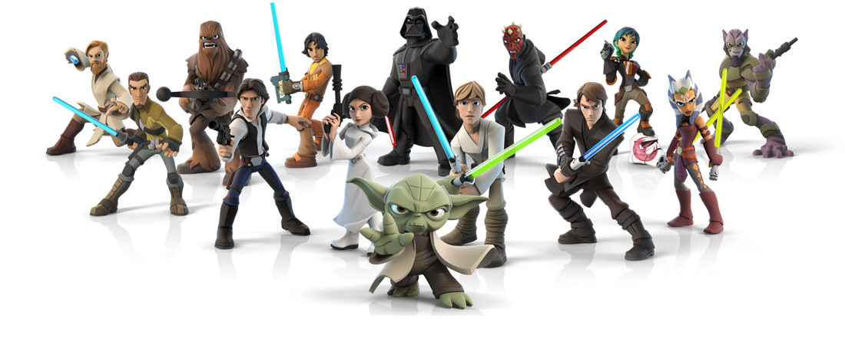
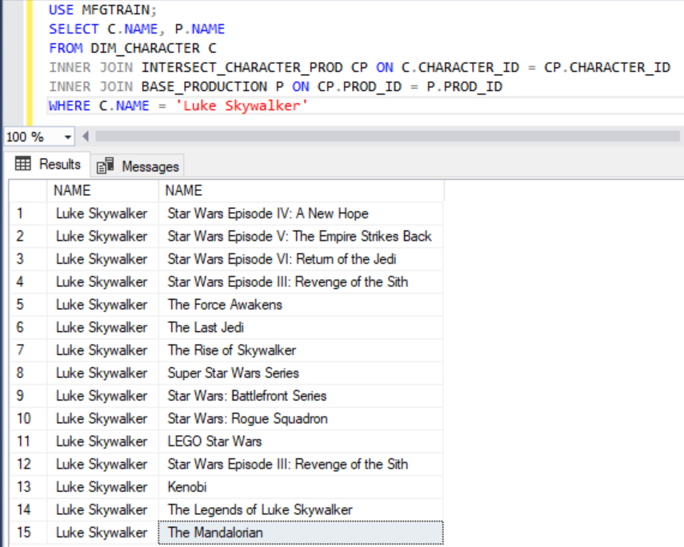
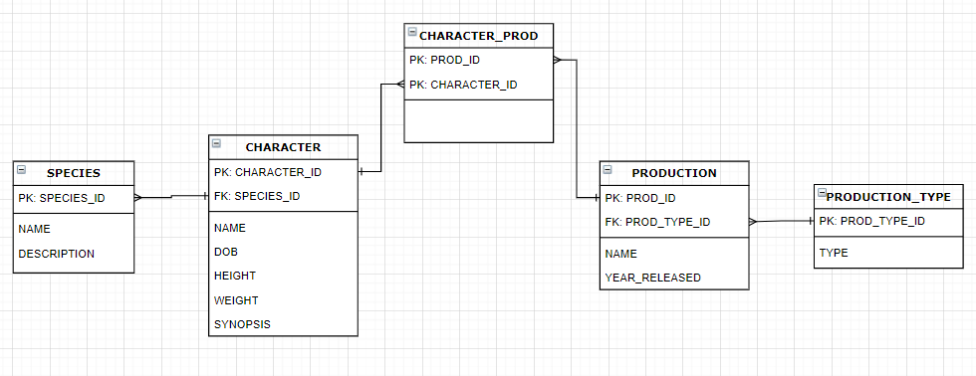
Star Wars Character Database Project
a. Entity Relation Diagram
b. Example
Notes:
Within this project I was able to review SQL and put my skills to practice by using a test environment database in Microsoft SQL Server Manager.
Here are a few deliverables from my Star Wars Character Database Project.
On the right we can see my Database Entity Relation Diagram which shows the relationship between all the tables in my database.
And on the left we can see an example report to find all the productions where Luke Skywalker appeared in.
I was able to utilize 2 join statements to merge the information in my tables to finally generate the report we see here!

